Slide 1
HTML-introduction
Basic of the HTML files

Slide 2
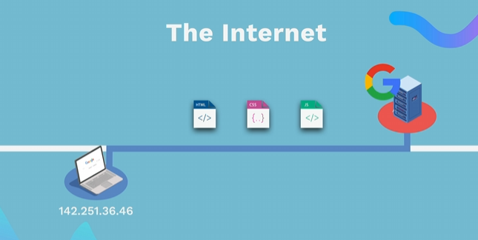
HOW WEBSITES WORK
👉 HTML (Content) - The structure of a web page (text, images, buttons). 👉 CSS (Styles) - Defines the layout (colors, fonts, arrangement of elements). 👉 JavaScript (Functionality)- Adds interactivity (click events, animations, form validation). The browser interprets and displays these files to display the web page.

Slide 3
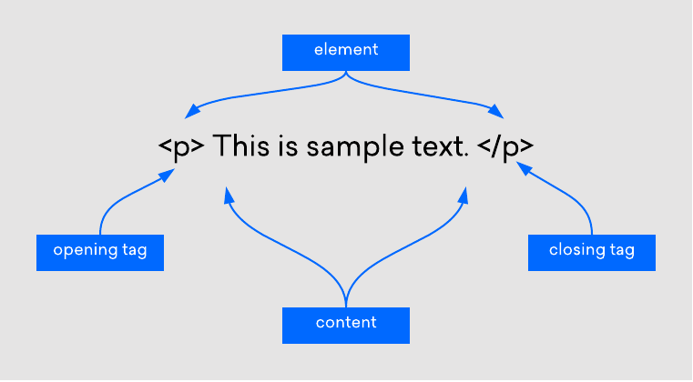
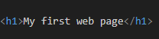
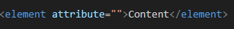
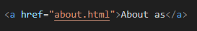
HTML
💡 Unlike CSS or JavaScript, a website can only exist with an HTML file 👉 Markup language: Similar to editorial markup in manuscripts (bold, underline, etc.) 👉 HTML uses tags to structure content

Slide 4
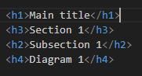
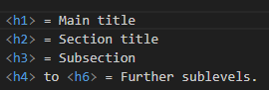
HTML TITLES

Slide 5
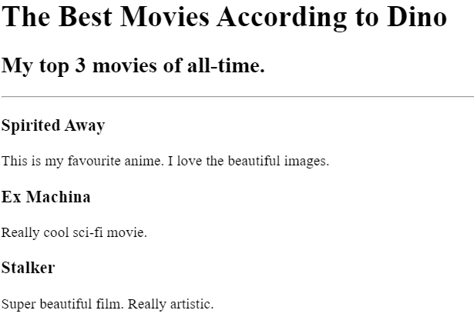
HTML TITLES – EXERCISE 1
💡 Install in VS code and use the Live Preview plugin to view changes in real-time 👉 Recreate image

Slide 6
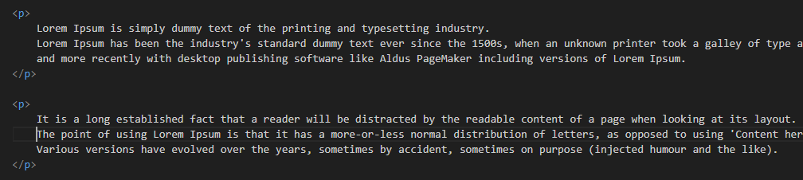
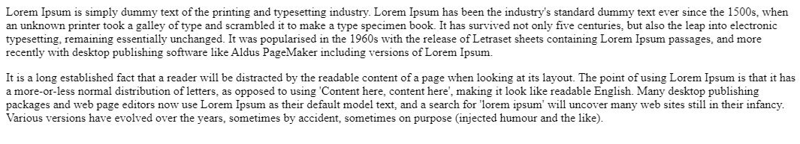
HTML PARAGRAF
💡 The paragraph element<p> is used to format the text into separate paragraphs 👉 Without <p> tags, all the text would be in one long block. 👉 It separates the text and adds visual spacing between paragraphs. 👉 Screen readers use <p> labels to help visually impaired users navigate through text

Slide 7
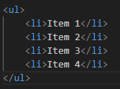
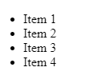
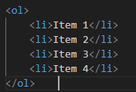
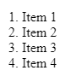
HTML LISTS
Unordered list
Ordered list
💡 It is used when the order is not important (e.g. shopping list).
💡 It is used when the order is not important (e.g. shopping list).

Slide 8
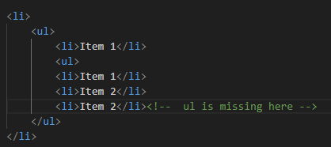
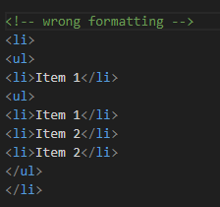
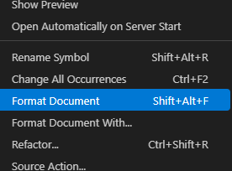
HTML LISTS
Common mistakes to avoid ❌ Forgetting to close tags (</ul> or </ol>).
❌ Incorrect code indentation, making it difficult to read and maintain.
❌ Setting </li> before closing a nested list instead of after it.

Slide 9
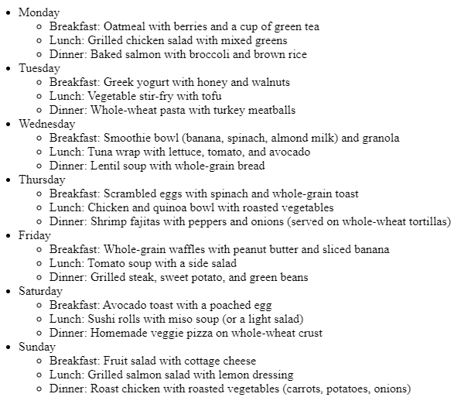
HTML LIST – EXERCISE 2
👉 Recreate image in html code

Slide 10
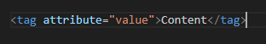
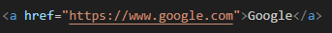
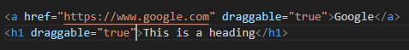
HTML ATTRIBUTES
💡 HTML elements can have attributes that add additional information about the element. 👉 Attributes are located inside the opening tag
https://www.w3schools.com/html/html_attributes.asp
Specific
Global

Slide 11
HTML ANCHOR
💡 Allows the creation of hyperlinks 👉 The href attribute specifies the URL to which the link leads. Attributes are located inside the opening tag 👉 Without the href attribute, the link is not active

Slide 12
HTML IMAGE
💡 Allows you to add images to our websites 👉 The src attribute (source) defines the source of the image 👉<img> It doesn't have a closing tag, because it's a void element.
Why is alt important? 👉 Helps blind and visually impaired people understand the content of the image. 👉 When an image can't load, alt text is displayed.

Slide 13
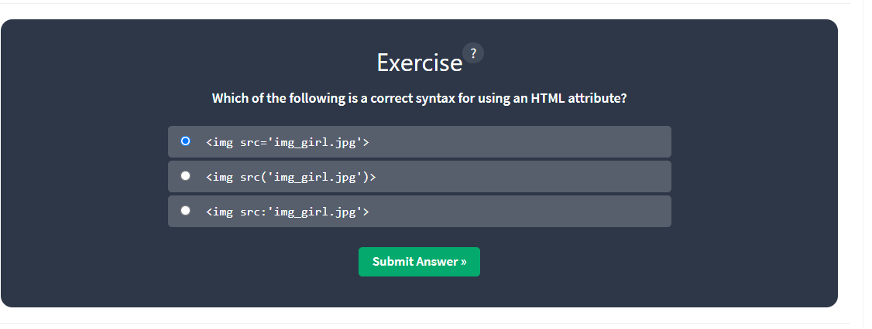
HTML ATTRIBUTES – EXERCISE 3
👉 Go to ://www.w3schools.com/html/html_attributes.asp and practice the quiz

Slide 14
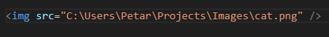
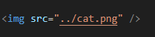
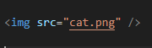
HTML PATHS
💡 A file path is a unique location on your computer where a specific file or folder is located. 👉 We can compare it to a real-world address
Absolute path
Relative path
One level up
Current directory

Slide 15
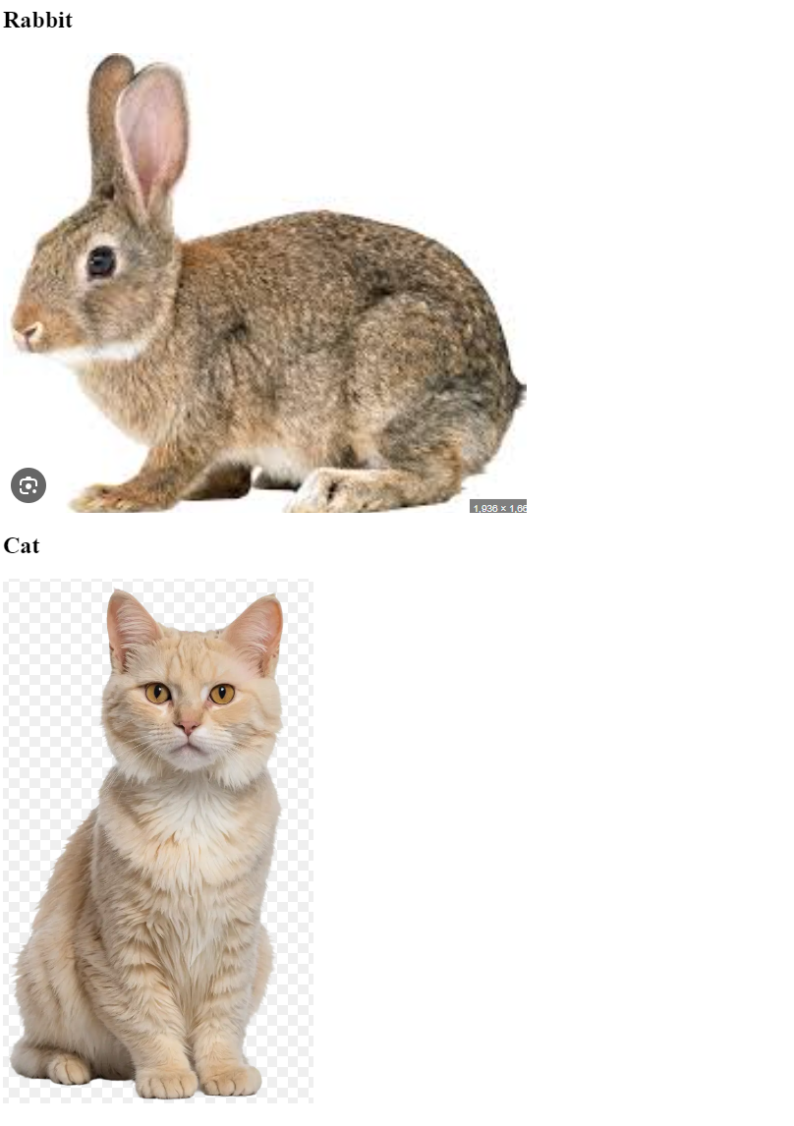
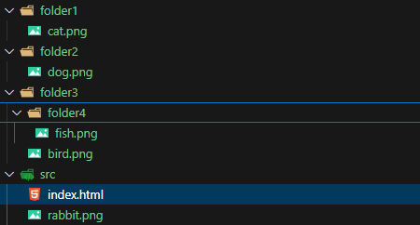
HTML IMAGES – EXERCISE 4
👉 Download 2.4-html-image-link project and connect the images in html file
👉 Replicate the image result

Slide 16
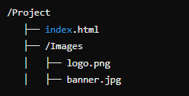
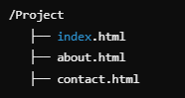
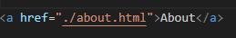
HTML MULTIPAGE
💡 To allow users to navigate through the site, we need to link pages using hyperlinks.
One page website
Multipage website
How to link a page
💡 Allows you to add images to our websites 👉 ./ means "search in the current directory". 👉 By clicking on the link, we will be taken to the "About Us" page.

Slide 17
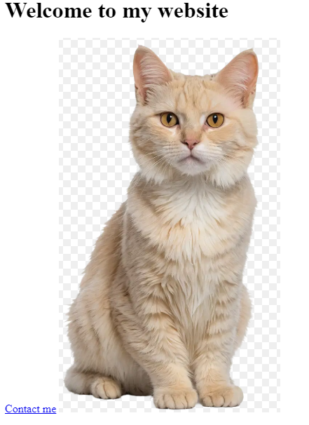
HTML LINKS – EXERCISE 5
Create a multi-page site 👉 Clicking on the image takes us to the about us page 👉 Click on Contact me, take us to the contact page

Slide 18
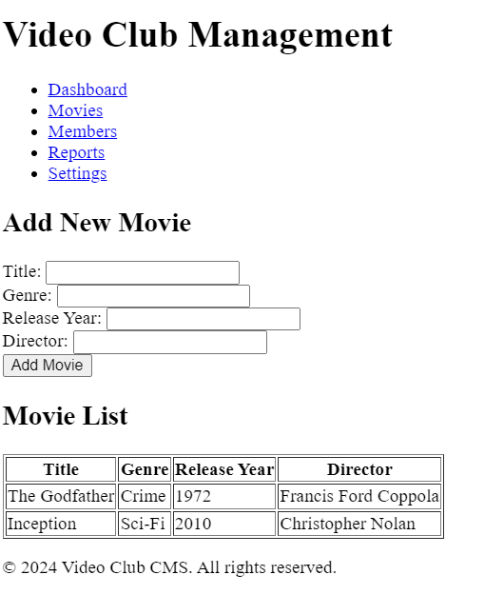
HTML – FINAL EXERCISE
HTML Task: Create a Basic CMS for a Video Club
Objective: Create a basic HTML skeleton for a Video Club CMS. The goal is to create a foundation that will later be enhanced with CSS and JavaScript. Once completed, upload the project to GitHub.
✅ Requirements: ✔️ Create a valid HTML skeleton ✔️ Include header, navigation, form, table, and footer ✔️ Add at least two sample movies ✔️ Code should be clean and properly indented ✔️ Upload the project to GitHub

